Slide 1
Measurement Project: Oscilloscope in LabView
Mohamed Mahmoud 252048
Vacca Andrea 252416
Thiam Papa 252113

Slide 2
Table of Contents
Introduction
Oscilloscope
SCPI Language
Block Diagram
Front Panel
Results and conclusions

Slide 3

Introduction
In this experiment we simulated this instrument, using the labview application by simulating a single channel.
Communication between the computer and the instrument is via a GPIB cable.
The language used in the communication is SCPI.

Slide 4
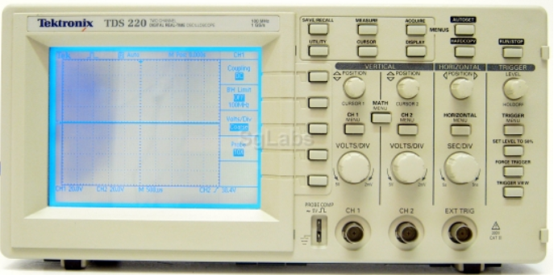
Oscilloscope
An oscilloscope is an electronic measuring instrument used to observe and analyze various electrical signals.
It is especially useful for visualizing the variation of a signal over time.
The oscilloscope used in this lab experience is manufactured by tektronix model tds220.
Modern oscilloscopes offer automatic measurements of various signal parameters such as frequency, period, amplitude, rise and fall time, duty cycle, etc. These measurements can be displayed directly on the screen.
The oscilloscope is an essential tool in electronics, providing a detailed view of electrical signals and allowing in-depth analysis of their temporal and amplitude characteristics.

Slide 5
SCPI Language
Standard Command for Programmable Instrumentation is a standardized control language used to program and communicate with electronic test and measurement instruments, such as oscilloscopes, multimeters, signal generators, and spectrum analyzers.
SCPI is a set of standardized commands and responses that allow users to control measurement instruments via communication interfaces such as GPIB (General Purpose Interface Bus), RS-232, USB, LAN and others.
It was developed to facilitate interoperability and programmability of instruments from different manufacturers, making integration and automation of test and measurement easier.
The language acts on the instrument through two actions, query or command.
Through a query we send an instruction , receiving a response from the instrument, while command is an action that is executed by the instrument without receiving feedback.

Slide 6
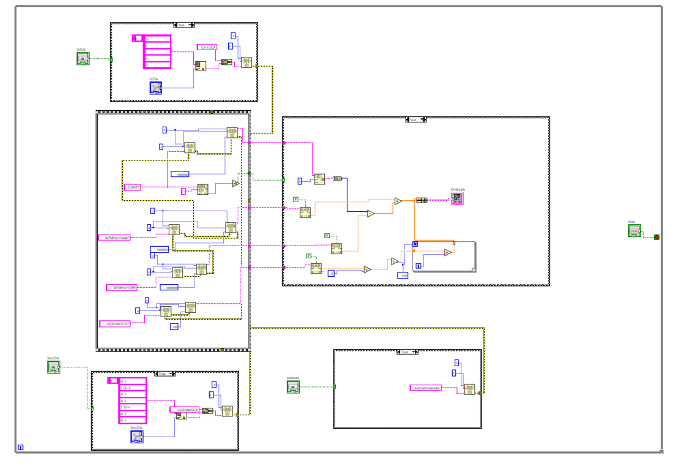
Block Diagram

Slide 7
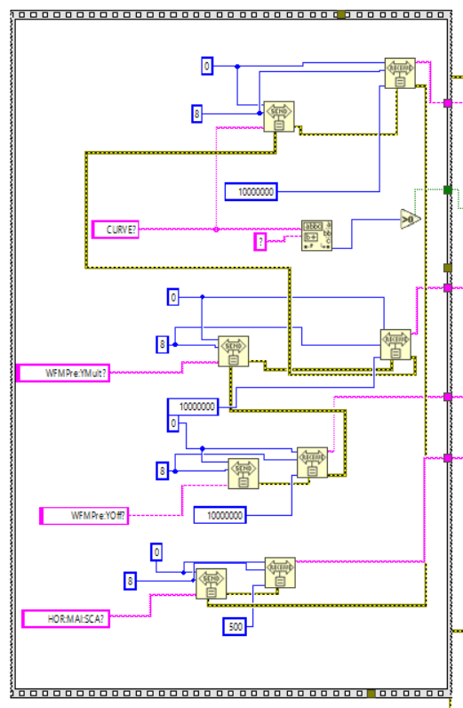
Block Diagram (Data Acquisition)
The first two blocks are called “Send” and “Receive.”
The Send block, sends data bytes to a single GPIB device.
Whereas the receive block, reads data bytes from a GPIB device.
A “Curve?” query is sent, acquires 2500 samples of the signal, of which the first six are information to be discarded.
In the following block, a query “WFMPre:YMult?” is sent, where the instrument responds to the query with the quantization step value.
Then a query “WFMPre:YOff?” is sent again, where the instrument gives us the offset on the Y axis in quantization levels
Finally, an additional query “HOR:MAI:SCA?” is sent, with which the oscilloscope gives us the value of seconds for each division on the X-axis.

Slide 8
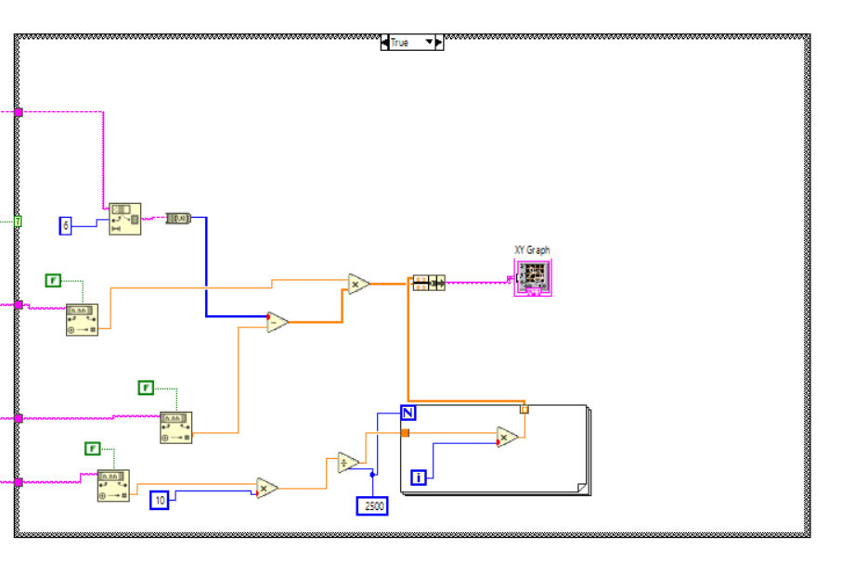
Block Diagram (Plotting Signals)
The first block “String Subset” allows us to discard the first six samples, i.e., information that is not useful.
The samples, in the form of strings, are converted to integers.
After that, mathematical operations are performed using quantization levels and quantization step to obtain on the Y-axis the amplitude of the signal in volts.
In the second part, the number of samples are used and, through mathematical operations, it is thus possible to obtain on the X axis the temporal values of the signal.

Slide 9
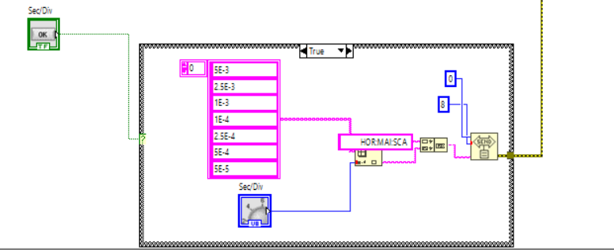
Block Diagram (Sec/Div)
To change the value of seconds on division a knob was created, where an independently chosen array of values is connected, using a “Concatenate String” block we concatenate the SCPI string that allows us to change the value of sec/div with the value imposed by the knob, all of which is sent to the oscilloscope.

Slide 10
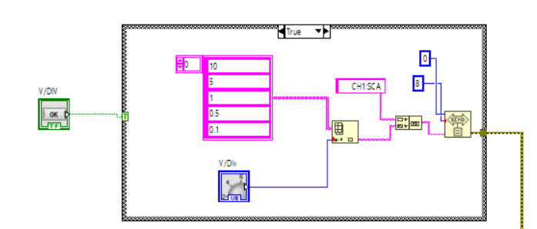
Block Diagram (Volt/Div)
To change the value of volts on division a knob has been created, where an array of independently chosen values is connected, using a “Concatenate String” block we concatenate the SCPI string that allows us to change the value of volts/div with the value imposed by the knob, all of which is sent to the oscilloscope.

Slide 11
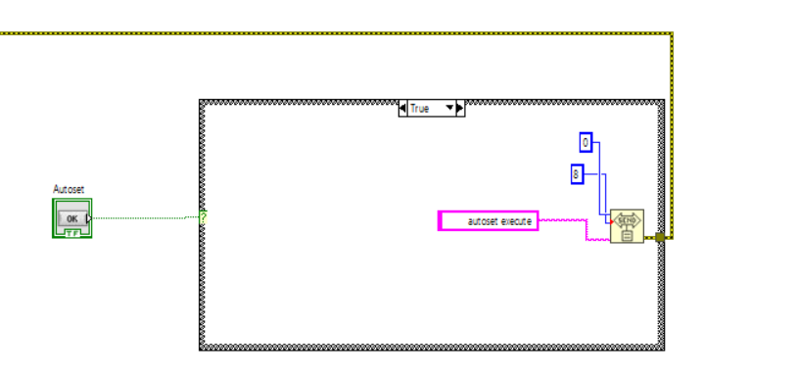
Block Diagram (Autoset)
an independent condition was created where, once the Autoset button on the front panel is pressed, the “Autoset execute” command is sent directly to the oscilloscope, which sets the ideal parameters to best display the signal.

Slide 12
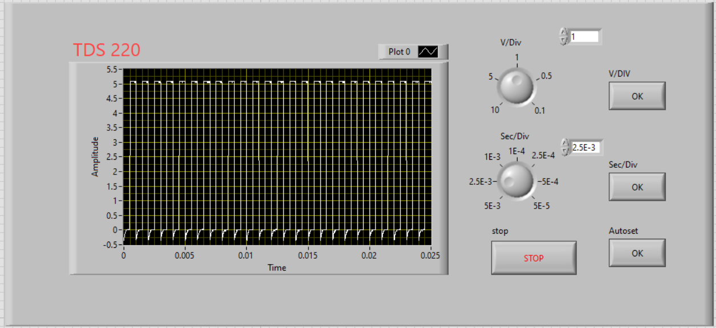
Front panel
From the user's point of view this is the usage screen.
the same design as in the physical oscilloscope has been reproduced where you can see the buttons that allow you to change the signal display parameters.
In addition, a stop button has been included to stop signal acquisition.

Slide 13
Results and Conclusions
The oscilloscope was tested in the laboratory with good results, no errors were found during the signal acquisition phase.
In this laboratory experience, it was intended to simulate only one channel, using this application to communicate with the instrument.
Future improvements could address remote communication and increase the number of available channels.

Slide 14

THANK YOU FOR YOUR ATTENTION!

